Slide 1

Operator-Framework Workshop
Extending the Kubernetes API

Slide 2
Extending The Kubernetes API
Resources
Custom Resources
Custom Resource Definitions

Slide 3
Defining: What is a Kubernetes Resource?
Extending the Kubernetes API
Source: https://kubernetes.io/docs/concepts/extend-kubernetes/api-extension/custom-resources/#custom-resources

Slide 4
We interact with resources in Kubernetes all the time.
Extending the Kubernetes API
Any Kind that you’ve ever targeted with kubectl or oc.
oc get pods
client
verb
kind
Translation “get me a collection of all pods in my namespace that currently exist”
For a full list, you can run the following command on your cluster: oc api-resources
Notes:
Kubernetes resources are effectively anything that is addressable via the API using the standard Uniform Resource Identifier understood by the Kubernetes APIServer.
If we’re familiar with clients, we understand that shown example indicates “get me a list of pods in my current namespace”.

Slide 5
Some assumptions have been made for us.
Extending the Kubernetes API
oc get pods
Actually queries the API host at this path:
${HOST}/api/v1/namespaces/my-namespace/pods
oc get deployments
Actually queries the API host at this path:
${HOST}/apis/apps/v1/namespaces/my-namespace/deployments
To see the full URL that is being queried for each kind, use the -v=10 flag e.g. oc get pods -v=10
Notes:
The client is handling formulating the URI for us so that we, as users, don’t have to remember the path/URI.
In effect, the path that’s passed in is our kubernetes “resource”.

Slide 6
What if we want objects in all namespaces for a Kind?
Extending the Kubernetes API
oc get deployments --all-namespaces
${HOST}/apis/apps/v1/deployments
compare to
${HOST}/apis/apps/v1/namespaces/my-namespace/deployments
Notes:
We have a known approach to requesting lists of Kinds from either all namespaces or our existing namespace (i.e. the namespace to which we are currently scoped).
That means that resources that can live cluster-wide or namespace-only have two resource paths for which they are addressable.

Slide 7
What about non-namespaced objects?
Extending the Kubernetes API
oc get namespaces
${HOST}/api/v1/namespaces
Notes:
Note the distinction here between the /api/ and /apis/ - the /api/ seems to refer to the core APIGroup (such as namespaces, pods, etc) and otherwise has no distinct behaviors other than being included with Kubernetes and therefore having no formal “Group” value.

Slide 8
We have a blueprint to extend the API.
Extending the Kubernetes API
We have a standard format to requesting different objects from the API server.
${HOST}/apis/GROUP/VERSION/KIND
${HOST}/apis/GROUP/VERSION/namespaces/my-namespace/KIND
With a standard format, there’s nothing stopping us from defining our own
Custom Resources
How do we define them?

Slide 9
What are Custom Resource Definitions?
Extending the Kubernetes API
An extension of the Kubernetes API
Contains all information necessary for the Kubernetes API to be able to accept a request for your object as valid.
Addressable just like any other Kubernetes API resource (e.g. Pods).
apps, storage.k8s.io
v1, v1beta1
Pods, Deployments
Group
Version
Kind
Specification
Aside from the Core API endpoints (e.g. Pods), all resources are organized into logical “groups”.
Your resource specification might evolve as your needs change, so you’ll associate a version with each specification.
This is how end-users will refer to your resource.
How your users define their intent, or desired layout for the given Kind.

Slide 10
What’s the Specification?
Extending the Kubernetes API

Slide 11
Creating Kubernetes Objects
Extending the Kubernetes API
oc apply -f - <<EOF
apiVersion: v1
kind: Pod
metadata:
name: nginx-pod
spec:
containers:
- name: nginx
image: nginx:latest
ports:
- containerPort: 80
EOF
curl \
--request POST \
--url http://localhost:8080/api/v1/namespaces/default/pods \
--header 'content-type: application/json' \
--data '{
"apiVersion":"v1",
"kind":"Pod",
"metadata":{
"name":"nginx-pod"
},
"spec":{
"containers":[
{
"name":"nginx",
"image":"nginx:latest",
"ports":[
{
"containerPort": 80
}
]
}
]
}
}'

Slide 12
What’s the Specification?
Extending the Kubernetes API
As an end user
Desired configuration of the resource I want. Ex:
What container image do I want to run?
What ports should be exposed on the network?
As an operator developer
Configuration that changes how my application is deployed.

Slide 13
Defining: What is a Kubernetes Resource?
A resource is an endpoint in the Kubernetes API that stores a collection of API objects of a certain kind; for example, the built-in pods resource contains a collection of Pod objects.
Extending the Kubernetes API
Through the use of the CustomResourceDefinition resource, we can define our own resources that can then be used by end-users.
Source: https://kubernetes.io/docs/concepts/extend-kubernetes/api-extension/custom-resources/#custom-resources

Slide 14
Working with Custom Resource Definitions
Anatomy of a CRD
Generating CRDs
CRD Validation
CRD Versioning

Slide 15
The Anatomy of a Custom Resource Definition
Working with Custom Resource Definitions

Slide 16
Custom Resource Definitions are just Kubernetes Objects.
Working with Custom Resource Definitions
Type Metadata
APIGroup
Kind
Object Metadata
Labels
Annotations
Spec
User provided desired state
Status
Controlled observed state of the world
Notes:
How do I tell the API how to extend itself to accept requests for other, previously unknown resources? Do that using another resource called CustomResourceDefinition

Slide 17
Type Metadata
Working with Custom Resource Definitions
kind: CustomResourceDefinition
apiVersion: apiextensions.k8s.io/v1
metadata:
...
spec:
...
Everything we need to build our URI*
/apis/apiextensions.k8s.io/v1/customresourcedefinitions
*Custom Resource Definition is a “cluster-scoped” resource, so no namespace value is required. Namespaced resources need additional information in the metadata.

Slide 18
Object Metadata
Working with Custom Resource Definitions
kind: CustomResourceDefinition
apiVersion: apiextensions.k8s.io/v1
metadata:
...
name: etcds.operator.openshift.io
uid: b8029967-d7c4-4ead-a44b-a9ed99232277
resourceVersion: '62981825'
generation: 1
creationTimestamp: '2020-12-07T18:34:39Z'
annotations:
...
labels:
...
spec:
...
Additional metadata specific to this instance of the given resource.
/apis/apiextensions.k8s.io/v1/customresourcedefinitions/etcds.operator.openshift.io

Slide 19
Spec
Working with Custom Resource Definitions
kind: CustomResourceDefinition
apiVersion: apiextensions.k8s.io/v1
metadata:
...
spec:
group: operator.openshift.io
names:
plural: etcds
singular: etcd
kind: Etcd
listKind: EtcdList
categories:
- coreoperators
scope: Cluster
versions:
- name: v1
served: true
storage: true
schema:
openAPIV3Schema:
...
All of the information necessary for the Kubernetes APIServer to handle requests for your new resource.
/apis/operator.openshift.io/<VERSION>/<KIND>
/apis/operator.openshift.io/<VERSION>/etcd
/apis/operator.openshift.io/v1/etcd
Notice that versions is a list!
We’ll talk about this soon!

Slide 20
Status
Working with Custom Resource Definitions
...
status:
conditions:
- type: NamesAccepted
status: 'True'
lastTransitionTime: '2020-12-07T18:34:40Z'
reason: NoConflicts
message: no conflicts found
- type: Established
status: 'True'
lastTransitionTime: '2020-12-07T18:34:40Z'
reason: InitialNamesAccepted
message: the initial names have been accepted
acceptedNames:
plural: etcds
singular: etcd
kind: Etcd
listKind: EtcdList
categories:
- coreoperators
storedVersions:
- v1
The current status of this resource as determined by the Kubernetes controller responsible for this particular Kind (Custom Resource Definition)

Slide 21
Declarative Spec of a Custom Resource
Working with Custom Resource Definitions

Slide 22
An Etcd Instance: Creating an instance
Working with Custom Resource Definitions
apiVersion: operator.openshift.io/v1
kind: Etcd
metadata:
annotations:
...
name: cluster
spec:
logLevel: Normal
managementState: Managed
operatorLogLevel: Normal
status:
conditions:
...

Slide 23
An Etcd Instance: What configuration can I declare?
Working with Custom Resource Definitions
KIND: Etcd
VERSION: operator.openshift.io/v1
RESOURCE: spec <Object>
DESCRIPTION:
<empty>
FIELDS:
failedRevisionLimit <integer>
failedRevisionLimit is the number of failed static pod installer revisions
to keep on disk and in the api -1 = unlimited, 0 or unset = 5 (default)
forceRedeploymentReason <string>
forceRedeploymentReason can be used to force the redeployment of the
operand by providing a unique string. This provides a mechanism to kick a
previously failed deployment and provide a reason why you think it will
work this time instead of failing again on the same config.
logLevel <string>
logLevel is an intent based logging for an overall component. It does not
give fine grained control, but it is a simple way to manage coarse grained
logging choices that operators have to interpret for their operands. Valid
values are: "Normal", "Debug", "Trace", "TraceAll". Defaults to "Normal".
managementState <string>
managementState indicates whether and how the operator should manage the
component
(continued)...
observedConfig <>
observedConfig holds a sparse config that controller has observed from the
cluster state. It exists in spec because it is an input to the level for
the operator
operatorLogLevel <string>
operatorLogLevel is an intent based logging for the operator itself. It
does not give fine grained control, but it is a simple way to manage coarse
grained logging choices that operators have to interpret for themselves.
Valid values are: "Normal", "Debug", "Trace", "TraceAll". Defaults to
"Normal".
succeededRevisionLimit <integer>
succeededRevisionLimit is the number of successful static pod installer
revisions to keep on disk and in the api -1 = unlimited, 0 or unset = 5
(default)
unsupportedConfigOverrides <>
unsupportedConfigOverrides holds a sparse config that will override any
previously set options. It only needs to be the fields to override it will
end up overlaying in the following order: 1. hardcoded defaults 2.
observedConfig 3. unsupportedConfigOverrides
Output of oc explain etc.spec in a cluster with the etcd operator installed

Slide 24
How do we tell the APIServer how to handle these configurations?
Working with Custom Resource Definitions
The CustomResourceDefinition spec accepts a schema definition using OpenAPI v3.

Slide 25
customresourcedefinition.spec.versions.*schema.openAPIV3Schema
Working with Custom Resource Definitions
kind: CustomResourceDefinition
apiVersion: apiextensions.k8s.io/v1
metadata:
...
spec:
...
versions:
- name: v1
served: true
storage: true
schema:
openAPIV3Schema:
...

Slide 26
A closer look at the schema
Working with Custom Resource Definitions
Let’s Go!

Slide 27
Summary
Working with Custom Resource Definitions
Custom Resource Definitions are instructions that tell the API server how to extend the API.
Includes a definition of all the valid configuration options a user has when interacting with this new custom Kind.
Allows for multiple versions of your kind, and with each version, a specification for how users can declare a desired state of your kind.

Slide 28
Writing CRDs

Slide 29
Writing CRDs by hand
Writing Custom Resource Definitions
Say we want our user to be able to create our custom application like this
apiVersion: operators.example.com/v1
kind: CustomApp
metadata:
name: application01
spec:
enableSelfPatching: true
enableMetricsEndpoint: true
logLevel: info
verbosityLevel: 2
backup:
dailyfrequency: 2
retentionSeconds: “172800”
Template: Link

Slide 30
<Text Editor - Writing a Custom Application CRD by hand>

Slide 31
Writing CRDs by hand is tedious
Writing Custom Resource Definitions
There must be a better way.
apiVersion: operators.example.com/v1
kind: CustomApp
metadata:
name: application01
spec:
enableSelfPatching: true
enableMetricsEndpoint: true
logLevel: info
verbosityLevel: 2
backup:
dailyfrequency: 2
retentionSeconds: “172800”
Template: Link

Slide 32
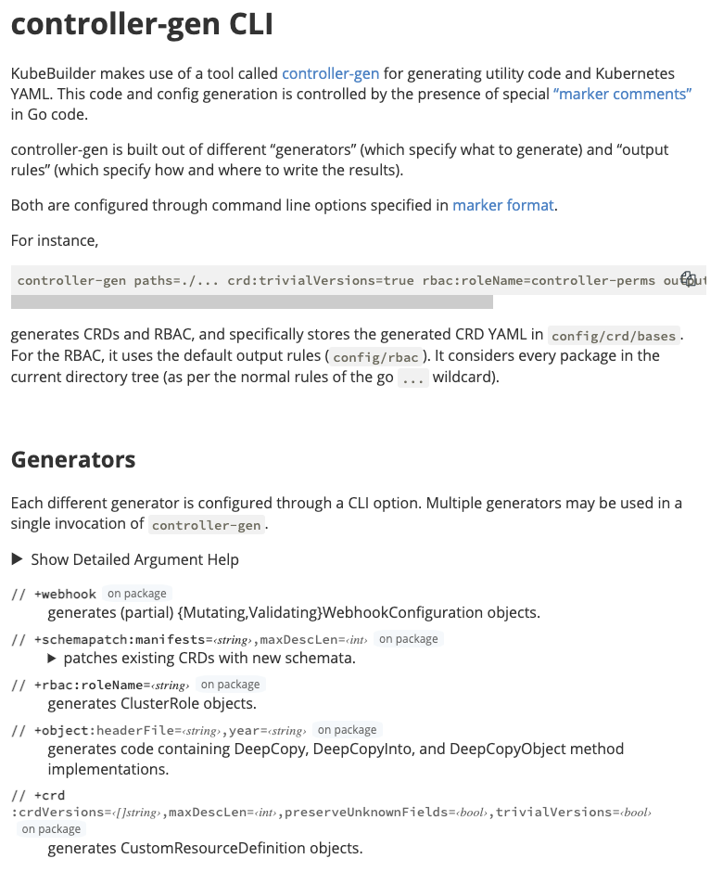
Tool: controller-gen
Writing Custom Resource Definitions
CLI tool that parses Golang code for the existence of markers.
Generates code/assets based on the markers found in your Golang codebase.
Vastly simplifies the generation of custom resources definitions.
Available as a Makefile target in OperatorSDK.
https://book.kubebuilder.io/reference/controller-gen.html
Template: Link

Slide 33
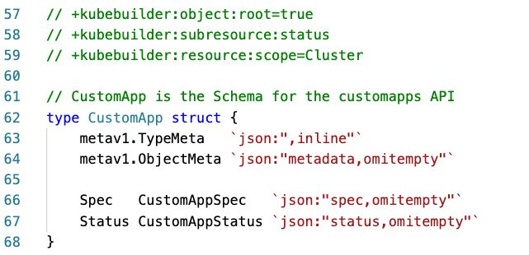
Markers in your code
Writing Custom Resource Definitions

Slide 34
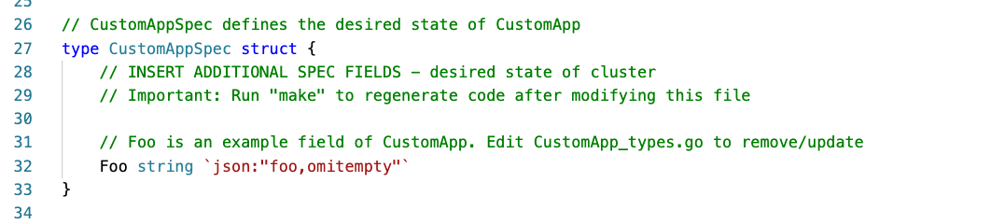
The Default Spec
Writing Custom Resource Definitions

Slide 35
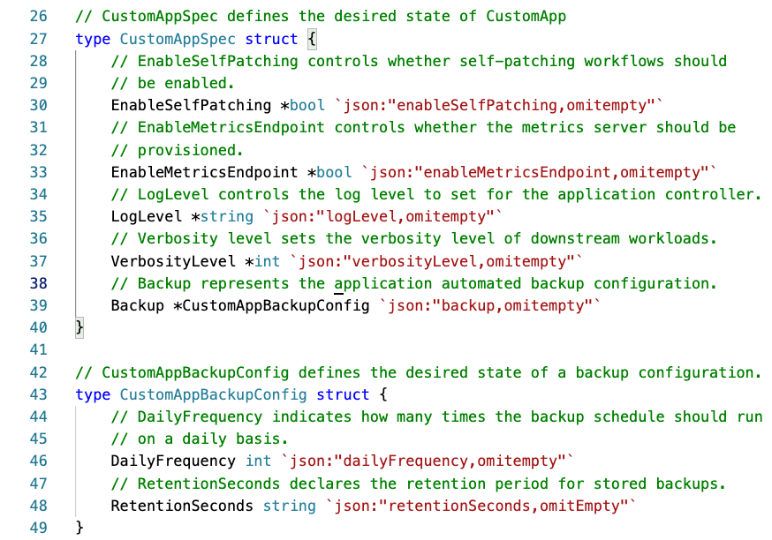
Updating the Spec
Writing Custom Resource Definitions

Slide 36
Generating the Custom Resource Definition
Writing Custom Resource Definitions
make generate
$(CONTROLLER_GEN) $(CRD_OPTIONS) rbac:roleName=manager-role webhook paths="./..." output:crd:artifacts:config=config/crd/bases

Slide 37
The Resulting CRD
Writing Custom Resource Definitions
Take a look!

Slide 38
Validating Custom Resources

Slide 39
Validating Custom Resources
Validating Custom Resource Definitions
How do I ensure the user provides the right type of values?
E.g. If the field calls for an integer, how do I prevent a string from being accepted?
apiVersion: operators.example.com/v1
kind: CustomApp
metadata:
name: application01
spec:
enableSelfPatching: true
enableMetricsEndpoint: true
logLevel: info
verbosityLevel: 2
backup:
dailyfrequency: 2
retentionSeconds: “172800”
How do I constrain the user to only certain values?
E.g. If I can only accept a value from a selection, how do I prevent something outside of that selection from being accepted?
How do I make sure users provide all required values?
E.g. if having a value omitted means I cannot proceed to manage an application, how do I make sure a user provides it?

Slide 40
Validating Custom Resource Definitions
spec:
...
versions:
- name: v1
schema:
openAPIV3Schema:
...
properties:
...
spec:
...
properties:
backup:
description: Backup represents the application automated backup configuration.
properties:
dailyFrequency:
description: DailyFrequency indicates how many times the backup
schedule should run on a daily basis.
type: integer
retentionSeconds:
description: RetentionSeconds declares the retention period for
stored backups.
type: string
type: object
enableMetricsEndpoint:
description: EnableMetricsEndpoint controls whether the metrics server
should be provisioned.
type: boolean
enableSelfPatching:
description: EnableSelfPatching controls whether self-patching workflows
should be enabled.
type: boolean
...
Implicit Validations
CRD (snippet)
apiVersion: operators.example.com/v1
kind: CustomApp
metadata:
name: application01
spec:
enableSelfPatching: true
enableMetricsEndpoint: true
logLevel: info
verbosityLevel: 2
backup:
dailyfrequency: 2
retentionSeconds: “172800”

Slide 41
Validating Custom Resource Definitions
Implicit Validations
apiVersion: operators.example.com/v1
kind: CustomApp
metadata:
name: application01
spec:
enableSelfPatching: true
enableMetricsEndpoint: true
logLevel: info
verbosityLevel: 2
backup:
dailyfrequency: 2
retentionSeconds: “172800”

Slide 42
Validating Custom Resource Definitions
Values from: info, warn, debug, trace
Values <= 3
Required
Even numbers <= 12

Slide 43
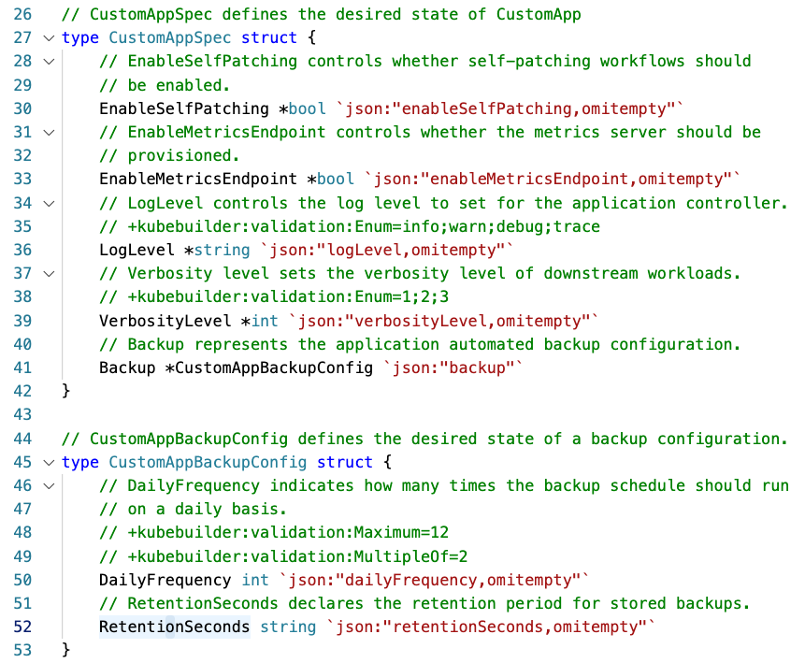
Validating Custom Resource Definitions

Slide 44
spec:
description: CustomAppSpec defines the desired state of CustomApp
properties:
backup:
description: Backup represents the application automated backup configuration.
properties:
dailyFrequency:
description: DailyFrequency indicates how many times the backup
schedule should run on a daily basis.
maximum: 12
multipleOf: 2
type: integer
retentionSeconds:
description: RetentionSeconds declares the retention period for
stored backups.
type: string
type: object
enableMetricsEndpoint:
description: EnableMetricsEndpoint controls whether the metrics server
should be provisioned.
type: boolean
enableSelfPatching:
description: EnableSelfPatching controls whether self-patching workflows
should be enabled.
type: boolean
logLevel:
description: LogLevel controls the log level to set for the application
controller.
enum:
- info
- warn
- debug
- trace
type: string
verbosityLevel:
description: Verbosity level sets the verbosity level of downstream
workloads.
enum:
- 1
- 2
- 3
type: integer
required:
- backup
type: object
Validating Custom Resource Definitions

Slide 45
All possible validations
Validating Custom Resource Definitions
https://book.kubebuilder.io/reference/markers/crd-validation.html

Slide 46
Complex Validations: Dynamic Admission Controllers
Validating Custom Resource Definitions
Validating Admission Webhooks
Mutating Admission Webhooks
Can handle complex validations, or validations that may not directly relate to the resource itself, but maybe requires tying into an external system (like validating that the creation of this resource does not violate a quota).
Handles making changes to the submitted resource, such as making complex decisions to determine defaulting logic.
Out of scope for this chapter.

Slide 47
Versioning Custom Resources

Slide 48
Your custom resources should be versioned!
Versioning Custom Resources
And why you might need multiple versions of your resource.
Your custom resource definition spec is your API
You may want to change your API to better fit your application as it evolves.
Users expect a certain degree of stability with your API - especially if you’ve promoted your API to a v1 and beyond.

Slide 49
Conversion Strategy: None
Versioning Custom Resources
A simple example. No change in the spec, just a promoted API.
apiVersion: operators.example.com/v1
kind: CustomApp
metadata:
name: application01
spec:
enableSelfPatching: true
enableMetricsEndpoint: true
logLevel: info
verbosityLevel: 2
backup:
dailyfrequency: 2
retentionSeconds: “172800”
apiVersion: operators.example.com/v2
kind: CustomApp
metadata:
name: application01
spec:
enableSelfPatching: true
enableMetricsEndpoint: true
logLevel: info
verbosityLevel: 2
backup:
dailyfrequency: 2
retentionSeconds: “172800”

Slide 50
Conversion Strategy: Webhook
Versioning Custom Resources
Changes in your spec across versions
apiVersion: operators.example.com/v1
kind: CustomApp
metadata:
name: application01
spec:
enableSelfPatching: true
enableMetricsEndpoint: true
logLevel: info
verbosityLevel: 2
backup:
dailyfrequency: 2
retentionSeconds: “172800”
apiVersion: operators.example.com/v2
kind: CustomApp
metadata:
name: application01
spec:
logLevel: info
verbosityLevel: 2
dailyBackupfrequency: 2
backupRetentionSeconds: “172800”
lifecyclePlugins:
enableSelfPatching: true
enableMetricsEndpoint: true
CRD Conversion Webhook

Slide 51
Supporting multiple versions
Versioning Custom Resources
---
apiVersion: apiextensions.k8s.io/v1
kind: CustomResourceDefinition
metadata:
name: customapps.operators.example.com
spec:
group: operators.example.com
names:
kind: CustomApp
...
scope: Cluster
versions:
- name: v1
schema:
...
served: true
storage: true
- name: v2
schema:
...
served: true
storage: false
Storage Version == persisted to Etcd
Served Version == can be requested via the API
One and only one version can be stored. The controller-gen tool allows you to indicate which version is stored using a marker.

Slide 52
Supporting multiple versions
Versioning Custom Resources
---
apiVersion: apiextensions.k8s.io/v1
kind: CustomResourceDefinition
metadata:
name: customapps.operators.example.com
spec:
group: operators.example.com
names:
kind: CustomApp
...
scope: Cluster
versions:
- name: v1
...
- name: v2
...
conversion:
strategy: Webhook
webhook:
conversionReviewVersions: ["v1","v2"]
clientConfig:
service:
namespace: default
name: example-conversion-webhook-server
path: /crdconvert
caBundle: "Ci0tLS0tQk...<base64-encoded PEM bundle>...tLS0K"
One and only one version can be stored.

Slide 53
Section Summary: Extending the API
Resources
Custom Resources
Custom Resource Definitions

